Slide 1
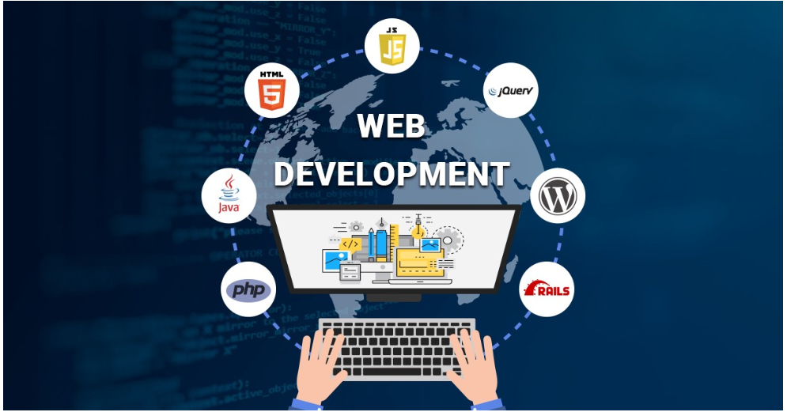

SUMMER INTERNTSHIP PROJECT on WEB DEVELOPMENT
Presented by
SK SHAMIM AKTAR
21IUT0010090
Supervisor
Swapan Das,
ICFAI Tripura

Slide 2


ABOUT TRAINING
Mode of Training :- from
Online
Internshala
Training Objectives
Understand the terms web development and website
Understand the significance of HTML,CSS,JS,Bootstrap,React,DBMS and PHP in building a web application
Understand the Future prospects of web development

Slide 3
CONTENTS
What is web development ?
Front end development
Back-end development
Full stack development
Full stack development technologies
Project
Conclusion

Slide 4

WHAT IS WEB DEVELOPMENT ?
Web development refers to the building, creating, and maintaining of websites.
It includes aspects such as web design, web publishing, web programming, and database management.
It is the creation of an application that works over the internet

Slide 5
WHO CREAT WEBSITE ?
A Web developer create website, there are three type of web development
Front-end developer
Back-end developer
Full stack developer

Slide 6

FRONT-END DEVELOPER
A front-end developer builds the front-end portion of websites and web applications that is the part that users see and interact with.
A front-end developer creates websites and applications using web languages such as HTML, CSS, and JavaScript allow users to access and interact with the site or app
When you visit a website, the design elements you see were created by a front-end developer.

Slide 7

BACK-END DEVELOPER
Back-end developers are the experts who build and maintain the mechanisms that process data and perform actions on websites.
Unlike front-end developer, who control everything we can see on a website, back-end developers are involved in data storage, security, and other server-side functions that we cannot see

Slide 8

FULL-STACK DEVELOPER
A full stack developer is someone who works with both the front end and back end of a web application. The front end is responsible for the visual look and feel of the website, while back end is responsible for the behind-the-scenes logic and infrastructure of the site.

Slide 9
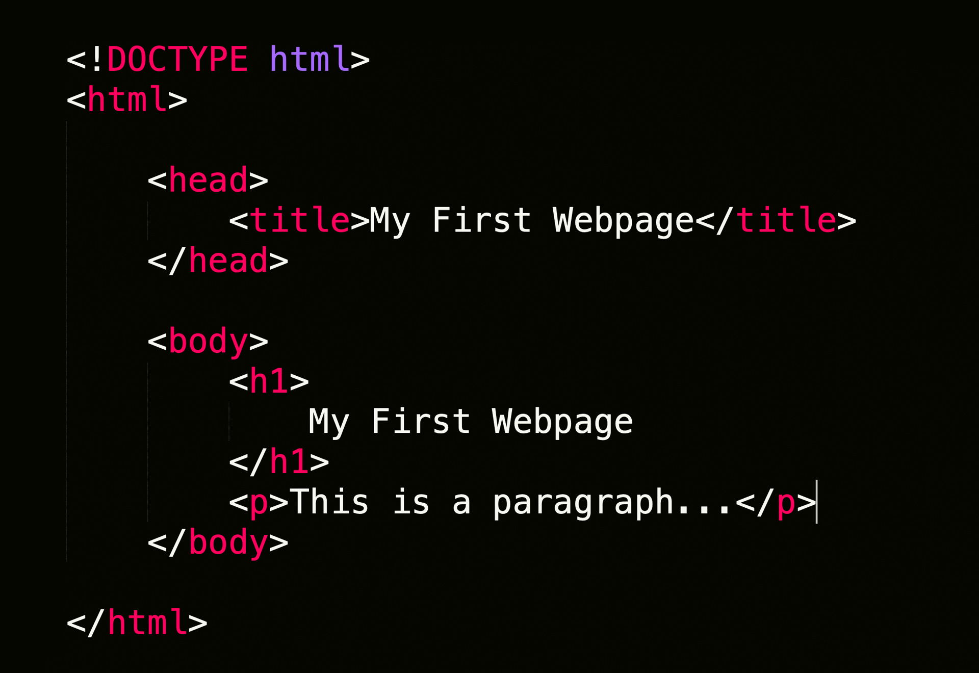
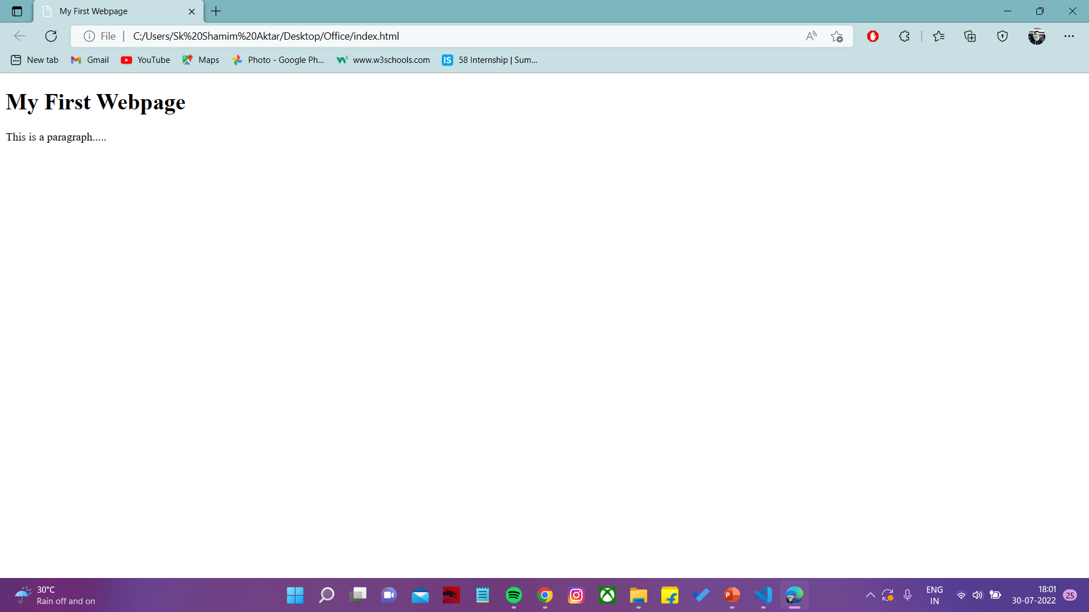
FULL-STACKDEVELOPER TECHNOLOGIES
HTML, CSS, Bootstrap, JS, React,
PHP,DBMS
HTML:
The Hyper Text Markup Language or HTML is the standard markup languages for documents designed to be displayed in a web pages.
Describe the structure of a web page and consists series of elements.
Its elements tell the browser how to display the content

Slide 10

FULL-STACKDEVELOPER TECHNOLOGIES
CSS
CSS Stands for Cascading style sheets
CSS describes how html elements are to be displayed on screen ,paper or other media,
CSS saves a lot of work it can control the layout of multiple web pages all at once
External style sheets are stored in CSS Files

Slide 11

FULL-STACKDEVELOPER TECHNOLOGIES
Bootstrap
Bootstrap is a free front end framework for faster and easier web development
Bootstrap include HTML and CSS based design templates for forms ,buttons ,table, navigation

Slide 12
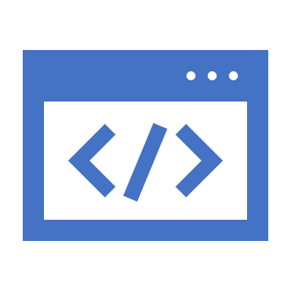
FULL-STACKDEVELOPER TECHNOLOGIES
JavaScript
JavaScript is a dynamic computer programming language. It is lightweight and most commonly used as a part of web pages, whose implementations allow client-side script to interact with the user and make dynamic pages. It is an interpreted programming language with object-oriented capabilities.
It is mainly used for:
➢ Client-side validation
➢ Dynamic drop-down menus.
➢ Displaying data and time.
➢ Displaying popup windows and dialog boxes (like alert dialog box, confirm dialog box and prompt dialog box).
➢ Displaying clocks etc.

Slide 13
FULL-STACKDEVELOPER TECHNOLOGIES
SQL
SQL stands for Structured Query Language
SQL is a standard language for accessing and manipulating databases.
SQL lets you access and manipulate databases
SQL became a standard of the American National Standards Institute (ANSI) in 1986, and of the International Organization for Standardization (ISO) in 1987

Slide 14
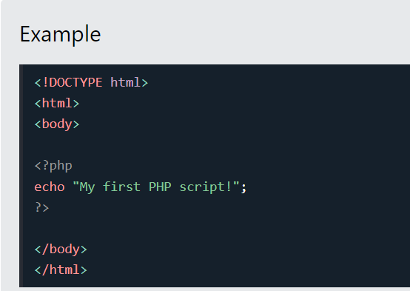
FULL-STACKDEVELOPER TECHNOLOGIES
PHP
HP is a server scripting language, and a powerful tool for making dynamic and interactive Web pages.
PHP is a widely-used, free, and efficient alternative to competitors such as Microsoft's ASP.
Start learning PHP now »

Slide 15
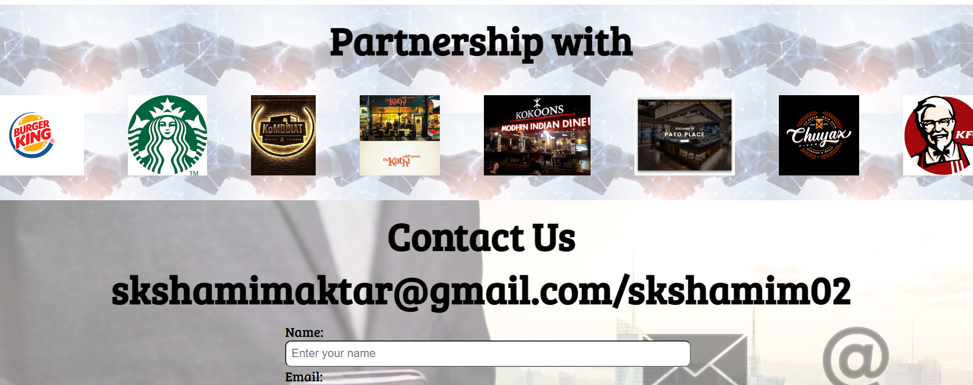
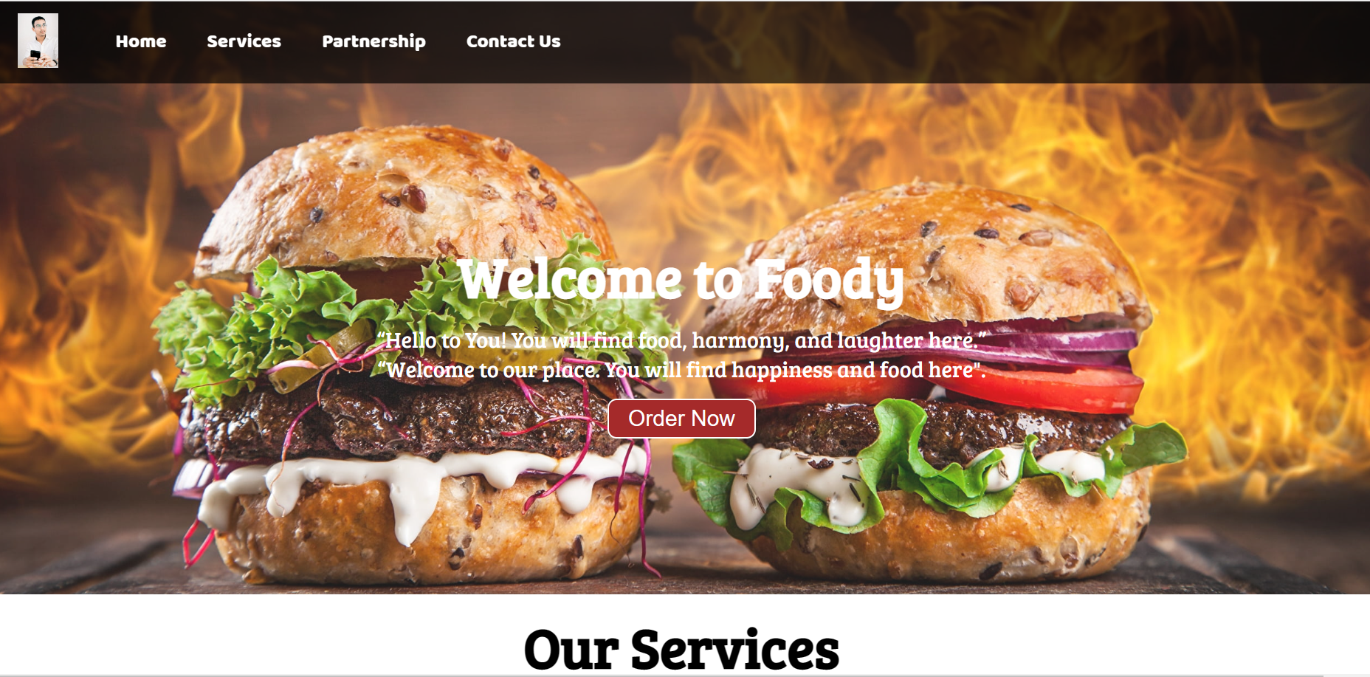
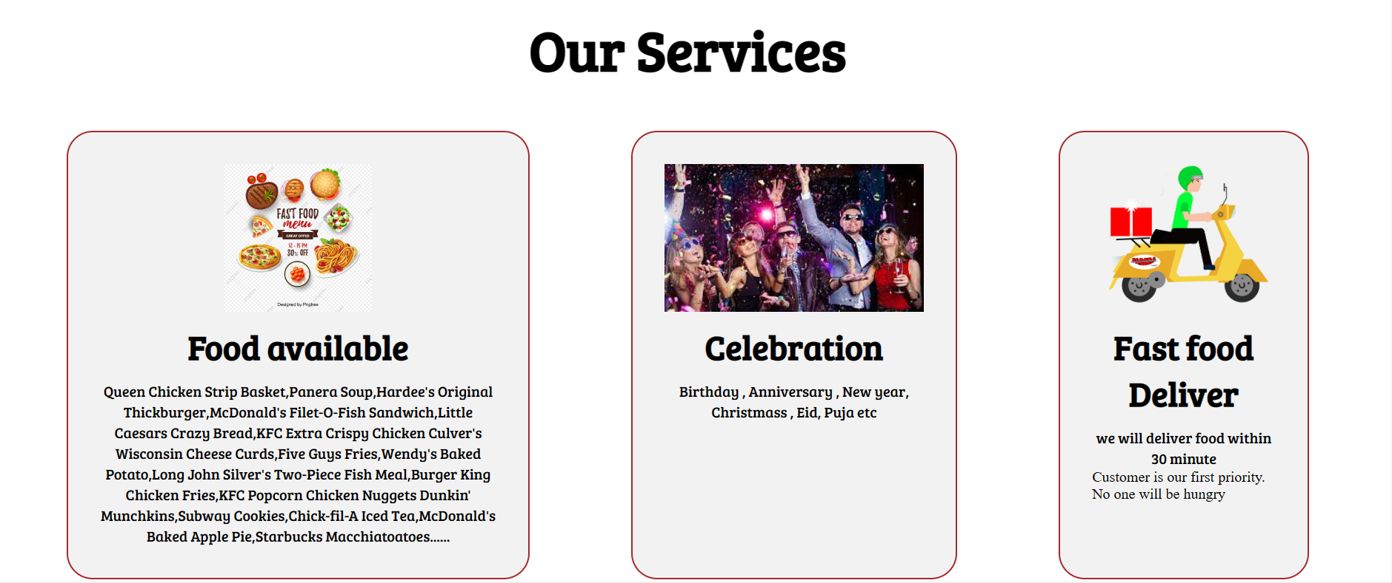
PROJECT :
E-COMMERCE WEBSITE

Slide 16
CONCLUSIONS
As a conclusion I can say that this training was a great experience, thanks to this project I acquired deeper knowledge concerning my technical skills but I also personally benefited
There are huge opportunities available for the students who want to work in this field. Many private and public organization hire web designer And web developer for their online work and website
Also, an experience person in this field can also work as a freelancer there are many online companies which provide online projects to the individuals

